Slide 1
Machine Learning
April-24-2015

Slide 2
A Few Quotes
“A breakthrough in machine learning would be worth ten Microsofts” (Bill Gates, Chairman, Microsoft)
“Machine learning is the next Internet” (Tony Tether, Director, DARPA)
“Machine learning is the hot new thing” (John Hennessy, President, Stanford)
“Web rankings today are mostly a matter of machine learning” (Prabhakar Raghavan, Dir. Research, Yahoo)
“Machine learning is going to result in a real revolution” (Greg Papadopoulos, CTO, Sun)
“Machine learning is today’s discontinuity” (Jerry Yang, CEO, Yahoo)

Slide 3
What is Learning ?
According to Herbert Simon (June 15, 1916 – February 9, 2001), learning is, “Any change in a System that allows it to perform better the second time on repetition of the same task or on another task drawn from the same population.” [G. F. Luger and W. A. Stubblefield, Artificial Intelligence: Structures and Strategies for Complex Problem Solving, The Benjamin/Cummings Publishing Company, Inc. 1989.]

Slide 4
So What Is Machine Learning?
Automating automation
Getting computers to program themselves
Writing software is the bottleneck
Let the data do the work instead!

Slide 5
Machine Learning…….
Traditional Programming
Data
Computer
Output
Program
Machine Learning
Data
Computer
Program
Output

Slide 6
Why “Learn”?
Machine learning is programming computers to optimize a performance criterion using example data or past experience.
There is no need to “learn” to calculate payroll
Learning is used when:
Human expertise does not exist (navigating on Mars),
Humans are unable to explain their expertise (speech recognition)
Solution changes in time (routing on a computer network)
Solution needs to be adapted to particular cases (user biometrics)

Slide 7
What We Talk About When We Talk About“Learning”
Learning general models from a data of particular examples
Data is cheap and abundant (data warehouses, data marts); knowledge is expensive and scarce.
Example in retail: Customer transactions to consumer behavior:
People who bought “Da Vinci Code” also bought “The Five People You Meet in Heaven” (www.amazon.com)
Build a model that is a good and useful approximation to the data.

Slide 8
Learning system model
Testing
Input Samples
Learning Method
System
Training

Slide 9
Training and testing
Data acquisition
Practical usage
Universal set
(unobserved)
Training set (observed)
Testing set
(unobserved)

Slide 10
Training and testing
Training is the process of making the system able to learn.
No free lunch rule:
Training set and testing set come from the same distribution
Need to make some assumptions or bias

Slide 11
Performance
There are several factors affecting the performance:
Types of training provided
The form and extent of any initial background knowledge
The type of feedback provided
The learning algorithms used
Two important factors:
Modeling
Optimization

Slide 12
Algorithms
The success of machine learning system also depends on the algorithms.
The algorithms control the search to find and build the knowledge structures.
The learning algorithms should extract useful information from training examples.

Slide 13


Algorithms
Supervised learning ( )
Prediction
Classification (discrete labels), Regression (real values)
Unsupervised learning ( )
Clustering
Probability distribution estimation
Finding association (in features)
Dimension reduction
Semi-supervised learning
Reinforcement learning
Decision making (robot, chess machine)

Slide 14
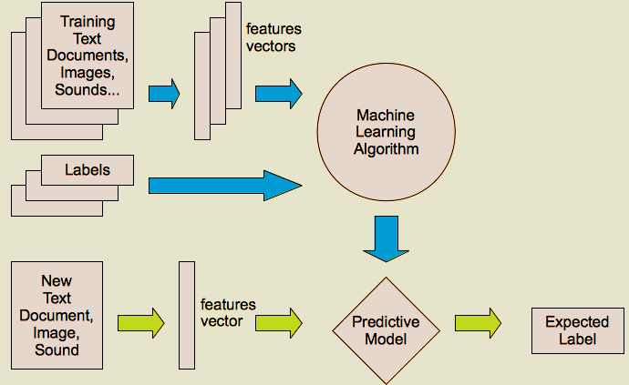
Supervised learning

Slide 15
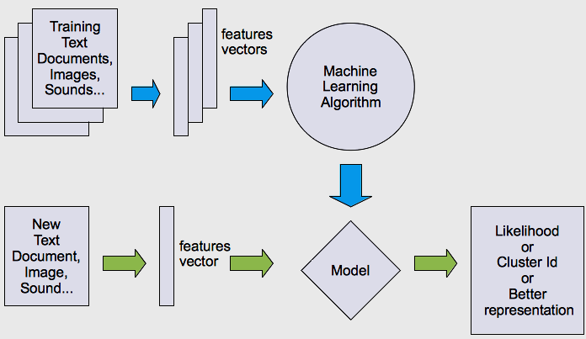
Unsupervised learning

Slide 16
Algorithms
Supervised learning
Unsupervised learning
Semi-supervised learning

Slide 17




What are we seeking?
Under-fitting VS. Over-fitting (fixed N)
error
(model = hypothesis + loss functions)

Slide 18
Learning techniques
Supervised learning categories and techniques
Linear classifier (numerical functions)
Parametric (Probabilistic functions)
Naïve Bayes, Gaussian discriminant analysis (GDA), Hidden Markov models (HMM), Probabilistic graphical models
Non-parametric (Instance-based functions)
K-nearest neighbors, Kernel regression, Kernel density estimation, Local regression
Non-metric (Symbolic functions)
Classification and regression tree (CART), decision tree
Aggregation
Bagging (bootstrap + aggregation), Adaboost, Random forest

Slide 19
Learning techniques
Unsupervised learning categories and techniques
Clustering
K-means clustering
Spectral clustering
Density Estimation
Gaussian mixture model (GMM)
Graphical models
Dimensionality reduction
Principal component analysis (PCA)
Factor analysis

Slide 20
Learning Associations
Basket analysis:
P (Y | X ) probability that somebody who buys X also buys Y where X and Y are products/services.
Example: P ( chips | beer ) = 0.7
Market-Basket transactions

Slide 21
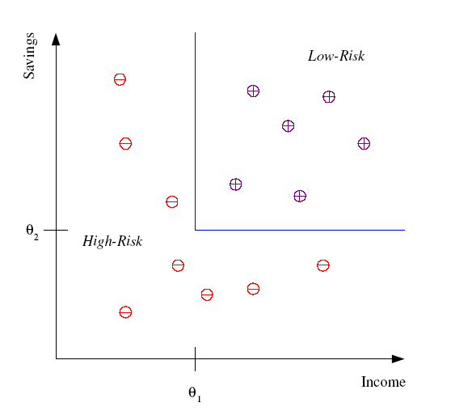
Classification
Example: Credit scoring
Differentiating between low-risk and high-risk customers from their income and savings
Discriminant: IF income > θ₁ AND savings > θ₂
THEN low-risk ELSE high-risk
Model

Slide 22
Classification: Applications
Aka Pattern recognition
Face recognition: Pose, lighting, occlusion (glasses, beard), make-up, hair style
Character recognition: Different handwriting styles.
Speech recognition: Temporal dependency.
Use of a dictionary or the syntax of the language.
Sensor fusion: Combine multiple modalities; eg, visual (lip image) and acoustic for speech
Medical diagnosis: From symptoms to illnesses
Web Advertizing: Predict if a user clicks on an ad on the Internet.

Slide 23








Face Recognition
Training examples of a person
Test images
AT&T Laboratories, Cambridge UK
http://www.uk.research.att.com/facedatabase.html

Slide 24
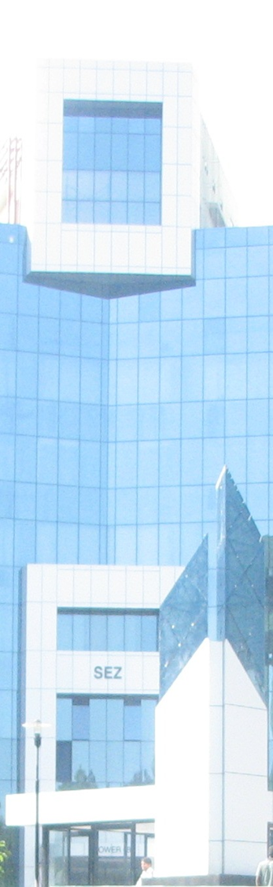

Artificial Neural Network

Slide 25
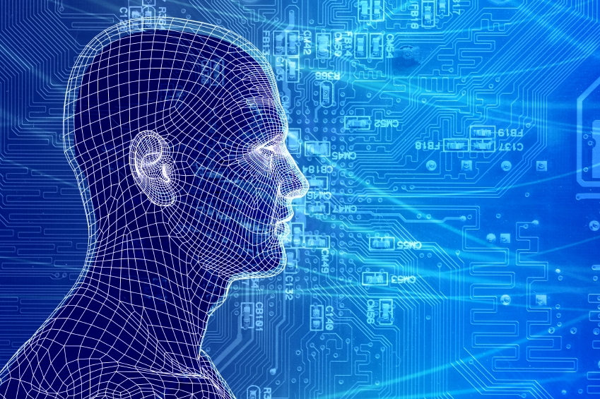
How do our brains work?
The Brain is A massively parallel information processing system.
Our brains are a huge network of processing elements. A typical brain contains a network of 10 billion neurons.

Slide 26
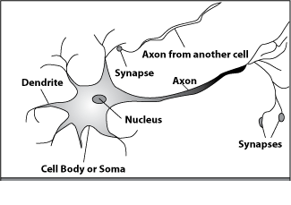
How do our brains work?
A processing element
Dendrites: Input
Cell body: Processor
Synaptic: Link
Axon: Output

Slide 27
How do our brains work?
A processing element
A neuron is connected to other neurons through about 10,000 synapses

Slide 28
How do our brains work?
A processing element
A neuron receives input from other neurons. Inputs are combined.

Slide 29
How do our brains work?
A processing element
Once input exceeds a critical level, the neuron discharges a spike ‐ an electrical pulse that travels from the body, down the axon, to the next neuron(s)

Slide 30
How do our brains work?
A processing element
The axon endings almost touch the dendrites or cell body of the next neuron.

Slide 31
How do our brains work?
A processing element
Transmission of an electrical signal from one neuron to the next is effected by neurotransmitters.

Slide 32
How do our brains work?
A processing element
Neurotransmitters are chemicals which are released from the first neuron and which bind to the Second.

Slide 33
How do our brains work?
A processing element
This link is called a synapse. The strength of the signal that reaches the next neuron depends on factors such as the amount of neurotransmitter available.

Slide 34
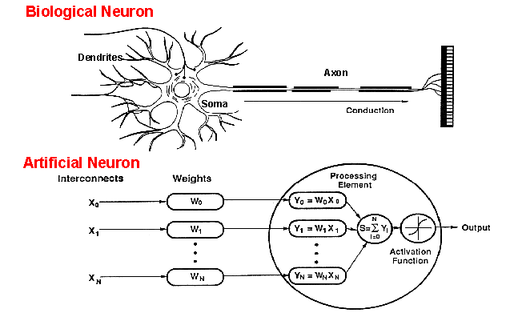
How do ANNs work?
An artificial neuron is an imitation of a human neuron

Slide 35
Artificial Neural Network

Slide 36
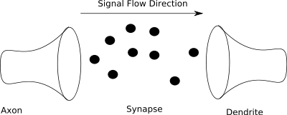
More on Synapse
The figure above shows a model of the synapse showing the chemical messages of the synapse moving from the axon to the dendrite.
Synapses are not simply a transmission medium for chemical signals, however. A synapse is capable of modifying itself based on the signal traffic that it receives.
In this way, a synapse is able to “learn” from its past activity. This learning happens through the strengthening or weakening of the connection

Slide 37
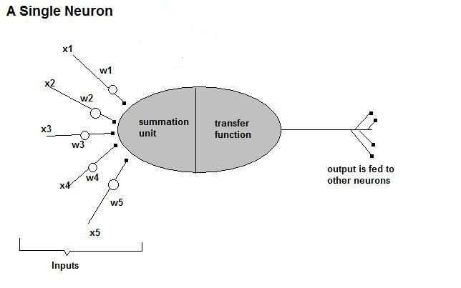
How do ANNs work?
Now, let us have a look at the model of an artificial neuron.

Slide 38
How do ANNs work?
Input
xm
. . . . . . . . . . . .
x2
x1
∑
Processing
∑= X₁+X₂ + ….+X_{m} =y
y
Output

Slide 39

How do ANNs work?
Not all inputs are equal
xm
. . . . . . . . . . . .
x2
x1
Input
weights
w_{m}
w₂
w₁
. . . . .
Processing
∑
∑= X₁w₁+X₂w₂ + ….+X_{m}w_{m} =y
Output
y

Slide 40

How do ANNs work?
The signal is not passed down to the
next neuron verbatim
xm
. . . . . . . . . . . .
x2
x1
Input
w_{m}
w₂
w₁
weights
. . . . .
Processing
∑
Transfer Function (Activation Function)
f(v_{k})
Output
y

Slide 41
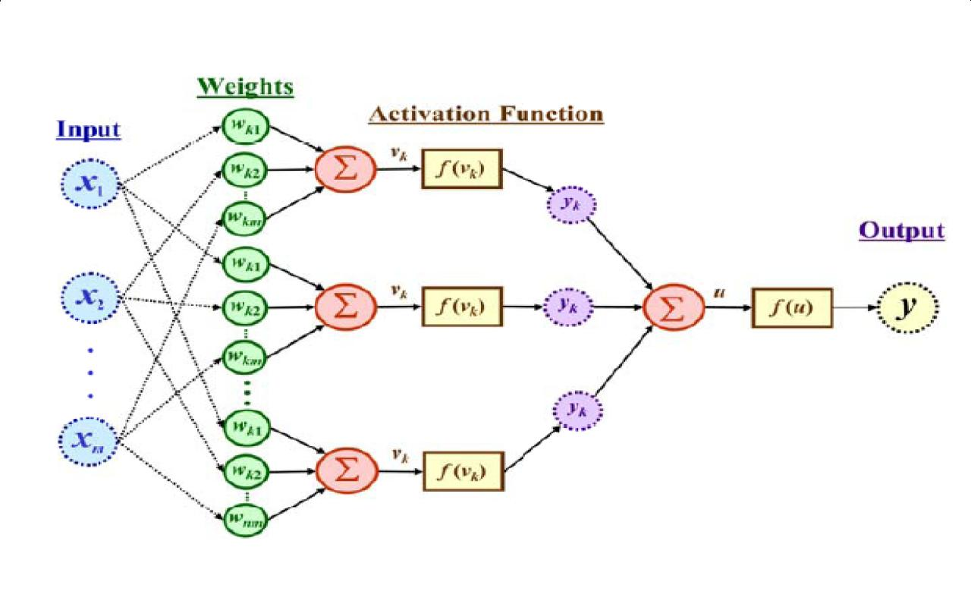
The output is a function of the input, that is affected by the weights, and the transfer functions

Slide 42
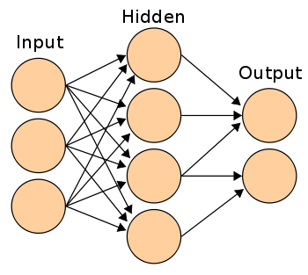
Three types of layers: Input, Hidden, and Output

Slide 43
Artificial Neural Networks
An ANN can:
compute any computable function, by the appropriate selection of the network topology and weights values.
learn from experience!
Specifically, by trial‐and‐error

Slide 44
Learning by trial‐and‐error
Continuous process of:
Trial:
Processing an input to produce an output (In terms of ANN: Compute the output function of a given input)
Evaluate:
Evaluating this output by comparing the actual output with the expected output.
Adjust:
Adjust the weights.

Slide 45
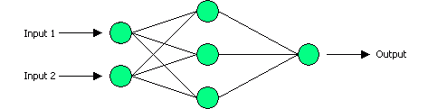
Example: XOR
Output Layer, with one neuron
Input Layer, with two neurons
Hidden Layer, with three neurons

Slide 46
How it works?
Output Layer, with one neuron
Input Layer, with two neurons
Hidden Layer, with three neurons

Slide 47
How it works?
Set initial values of the weights randomly.
Input: truth table of the XOR
Do
Read input (e.g. 0, and 0)
Compute an output (e.g. 0.60543)
Compare it to the expected output. (Diff= 0.60543)
Modify the weights accordingly.
Loop until a condition is met
Condition: certain number of iterations
Condition: error threshold

Slide 48
Design Issues
Initial weights (small random values ∈[‐1,1])
Transfer function (How the inputs and the weights are combined to produce output?)
Error estimation
Weights adjusting
Number of neurons
Data representation
Size of training set

Slide 49
Transfer Functions
Linear: The output is proportional to the total weighted input.
Threshold: The output is set at one of two values, depending on whether the total weighted input is greater than or less than some threshold value.
Non‐linear: The output varies continuously but not linearly as the input changes.

Slide 50
Error Estimation
The root mean square error (RMSE) is a frequently-used measure of the differences between values predicted by a model or an estimator and the values actually observed from the thing being modeled or estimated

Slide 51
Weights Adjusting
After each iteration, weights should be adjusted to minimize the error.
– All possible weights
– Back propagation

Slide 52
Back Propagation
Back-propagation is an example of supervised learning is used at each layer to minimize the error between the layer’s response and the actual data
The error at each hidden layer is an average of the evaluated error
Hidden layer networks are trained this way

Slide 53
Back Propagation
N is a neuron.
N_{w} is one of N’s inputs weights
N_{out} is N’s output.
N_{w} = N_{w} +Δ N_{w}
Δ N_{w} = N_{out} * (1‐ N_{out})* N_{ErrorFactor}
N_{ErrorFactor} = N_{ExpectedOutput} – N_{ActualOutput}
This works only for the last layer, as we can know the actual output, and the expected output.

Slide 54
Number of neurons
Many neurons:
Higher accuracy
Slower
Risk of over‐fitting
Memorizing, rather than understanding
The network will be useless with new problems.
Few neurons:
Lower accuracy
Inability to learn at all
Optimal number.

Slide 55
Size of training set
No one‐fits‐all formula
Over fitting can occur if a “good” training set is not chosen
What constitutes a “good” training set?
Samples must represent the general population.
Samples must contain members of each class.
Samples in each class must contain a wide range of variations or noise effect.
The size of the training set is related to the number of hidden neurons

Slide 56
Learning Paradigms
Supervised learning
Unsupervised learning
Reinforcement learning

Slide 57
Supervised learning
This is what we have seen so far!
A network is fed with a set of training samples (inputs and corresponding output), and it uses these samples to learn the general relationship between the inputs and the outputs.
This relationship is represented by the values of the weights of the trained network.

Slide 58
Unsupervised learning
No desired output is associated with the training data!
Faster than supervised learning
Used to find out structures within data:
Clustering
Compression

Slide 59
Reinforcement learning
Like supervised learning, but:
Weights adjusting is not directly related to the error value.
The error value is used to randomly, shuffle weights!
Relatively slow learning due to ‘randomness’.

Slide 60
Applications Areas
Function approximation
including time series prediction and modelling.
Classification
including patterns and sequences recognition, novelty detection and sequential decision making.
(radar systems, face identification, handwritten text recognition)
Data processing
including filtering, clustering blinds source separation and compression.
(data mining, e-mail Spam filtering)

Slide 61
Advantages / Disadvantages
Advantages
Adapt to unknown situations
Powerful, it can model complex functions.
Ease of use, learns by example, and very little user domain‐specific expertise needed
Disadvantages
Not exact
Large complexity of the network structure

Slide 62
Conclusion
Artificial Neural Networks are an imitation of the biological neural networks, but much simpler ones.
The computing would have a lot to gain from neural networks. Their ability to learn by example makes them very flexible and powerful furthermore there is need to device an algorithm in order to perform a specific task.

Slide 63
Conclusion
Neural networks also contributes to area of research such a neurology and psychology. They are regularly used to model parts of living organizations and to investigate the internal mechanisms of the brain.
Many factors affect the performance of ANNs, such as the transfer functions, size of training sample, network topology, weights adjusting algorithm, …

Slide 64
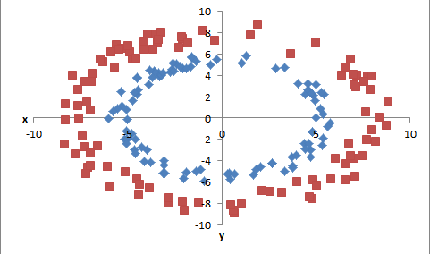
Support Vector Machine

Slide 65
Support Vector Machine
In machine learning, support vector machines are supervised learning models
Given a set of training examples, each marked as belonging to one of two categories, an SVM training algorithm builds a model that assigns new examples into one category or the other.
An SVM model is a representation of the examples as points in space, mapped so that the examples of the separate categories are divided by a clear gap that is as wide as possible. New examples are then mapped into that same space and predicted to belong to a category based on which side of the gap they fall on.
In addition to performing linear classification, SVMs can efficiently perform a non-linear classification using what is called the kernel trick, implicitly mapping their inputs into high-dimensional feature spaces.

Slide 66
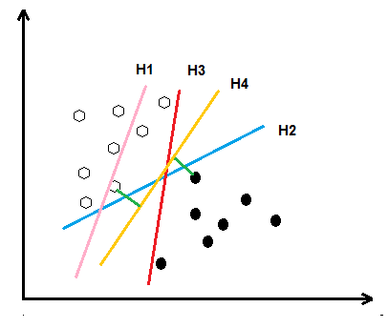
Support Vector Machine
H1: Does not separate the classes
H2 and H3: Separate the classes but with minimum Margin
H4: Separate the classes with maximum Margin

Slide 67
SVM Classification

Slide 68
SVM Classification

Slide 69
SVM Classification

Slide 70
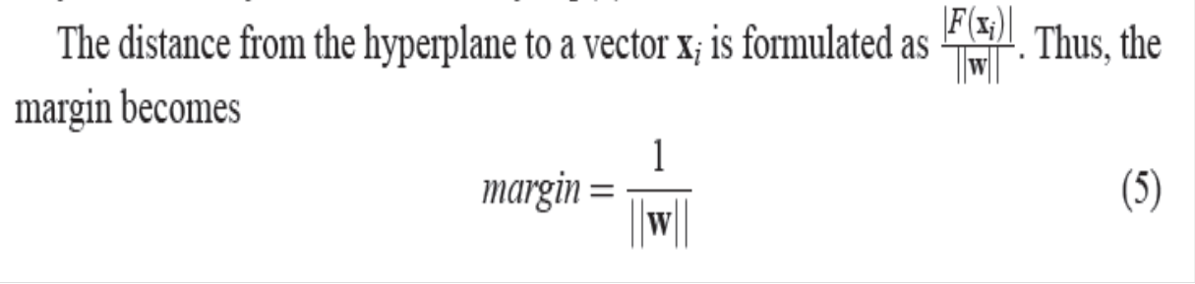
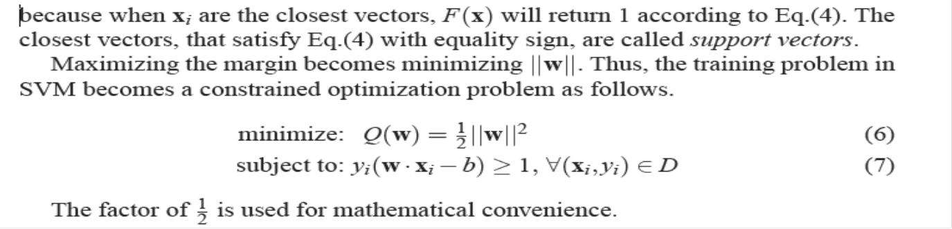
SVM Classification

Slide 71

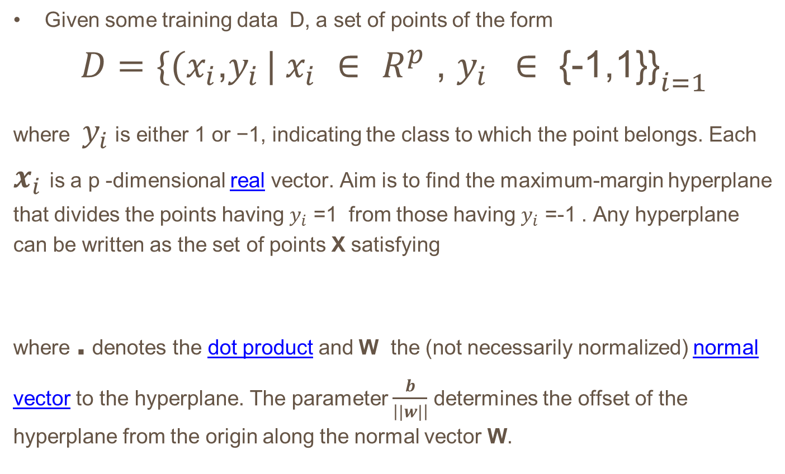
Linear SVM
Given some training data D, a set of points of the form
$$D={\{(x_{i}\text{,}y_{i }| x_{i} ∈ R^{p}\text{ , }y_{i } ∈\text{ \{−1,1\}\}}}_{i=1}^{}$$
where $y_{i}$ is either 1 or −1, indicating the class to which the point belongs. Each $x_{i}$is a p -dimensional real vector. Aim is to find the maximum-margin hyperplane that divides the points having $y_{i}$ =1 from those having $y_{i}$ =-1 . Any hyperplane can be written as the set of points X satisfying
where . denotes the dot product and W the (not necessarily normalized) normal vector to the hyperplane. The parameter $\frac{b}{\left||w|\right|}$ determines the offset of the hyperplane from the origin along the normal vector W.
W . X - b =0

Slide 72
Support Vector Machine
If the training data are linearly separable, we can select two hyperplanes in a way that they separate the data and there are no points between them, and then try to maximize their distance. The region bounded by them is called "the margin". These hyperplanes can be described by the equations
and
W . X - b = 1
W . X - b = -1

Slide 73
Support Vector Machine
Maximum-margin hyperplane and margins for an SVM trained with samples from two classes. Samples on the margin are called the support vectors

Slide 74






Support Vector Machine
By using geometry, we find the distance between these two hyperplanes is
so we want to minimize . As we also have to prevent data points from falling into the margin, we add the following constraint: for each i either
of the first class
Or
of the second.
This can be rewritten as:
We can put this together to get the optimization problem:
Minimize (in w, b )

Slide 75
Support Vector Machine

Slide 76

Support Vector Machine cont..

Slide 77
Support Vectors

Slide 78
Support Vector Machine cont..
This new formulation LD is referred to as the Dual form of the Primary LP . It is worth noting that the Dual form requires
only the dot product of each input vector xi to be calculated,
This is precisely what lets us generalize to the nonlinear case.

Slide 79
Constrained Optimization Problem
A constrained optimization problem is a problem of the form maximize (or minimize) the function F(x, y) subject to the condition g(x, y) = 0.
Procedure for Applying the Method of Lagrange Multipliers:
Step #1 First create the LaGrange Function. This function is composed of the function to be optimized combined with the constraint function in the following way:
L(x, y) = f(x, y) – λ [ g(x, y) – k ]
Step #2 Now find the partial derivative with respect to each variable x, y and the Lagrange multiplier $⋋$ of the function shown:
L(x, y) = f(x, y) –λ [ g(x, y) – k ]
Step #3 Set each of the partial derivatives equal to zero to get Lx = 0, Ly = 0 and L_{λ} = 0
Using Lx = 0, Ly = 0, proceed to solve for x and solve for y in terms of λ. Now substitute the solutions for x and y so that L_{λ} = 0 is in terms of λ only. Now solve for λ and use this value to find the optimal values x and y.
Note: If M is the max or min value of f(x, y) subject to the constraint g(x, y) = k, then the Lagrange multiplier λ is the rate of change in M with respect to k.

Slide 80
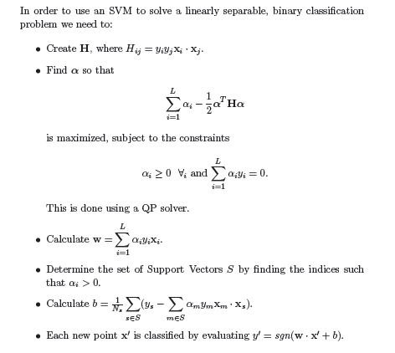
Procedure for Applying the Method of Lagrange Multipliers:

Slide 81
Support Vector Machine
The input x and the support vectors xi are nonlinearly mapped (by F) into a feature space F, where dot products are computed. By the use of the kernel k, these two layers are in practice computed in one single step. The results are linearly combined by weights ni, found by solving a quadratic program. The linear combination is fed into the function s (in pattern recognition, s(x) = sign(x + b); in
regression stimation, s(x) = x + b; in kernel PCA, s(x) = x.

Slide 82


Feature Space and Kernel
The basic idea of SV machines, is to map the data into some other dot product space (called the feature space) F via a nonlinear map
and perform the above linear algorithm in F. Pl note as stated this only requires the evaluation of dot products.
Clearly, if F is high-dimensional, the right hand side of Equation will be very expensive to compute. In some cases, however, there is a simple kernel k that can be evaluated efficiently.

Slide 83
Support Vector Machine
Clearly, if F is high-dimensional, the right hand side of Equation will be very expensive to compute. In some cases, however, there is a simple kernel k that can be evaluated efficiently.

Slide 84

THANK YOU!

Slide 85
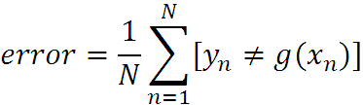
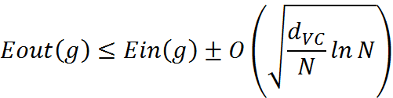
What are we seeking?
Supervised: Low E-out or maximize probabilistic terms
Unsupervised: Minimum quantization error, Minimum distance, MAP, MLE(maximum likelihood estimation)
Data table, LIPS
E-in: for training set
E-out: for testing set

